Slide 1
Heart Disease Prediction
CS-185C
By:
Bernard Tan

Slide 2
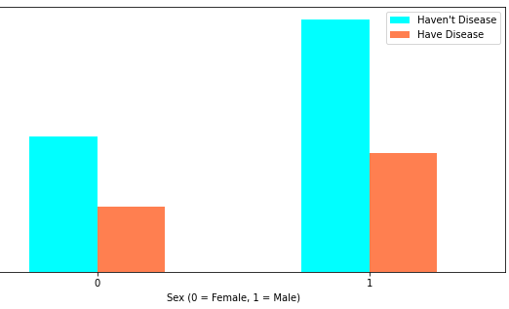
Data Visualization
Total people who have heart disease and does not have heart disease
Notes:
So in order to develop the machine learning training pipeline by using the data visualization, I did not add a new column for the custom transformator as I believe that the data is already good enough to help predict the heart disease. Here are some of the data that I get.

Slide 3
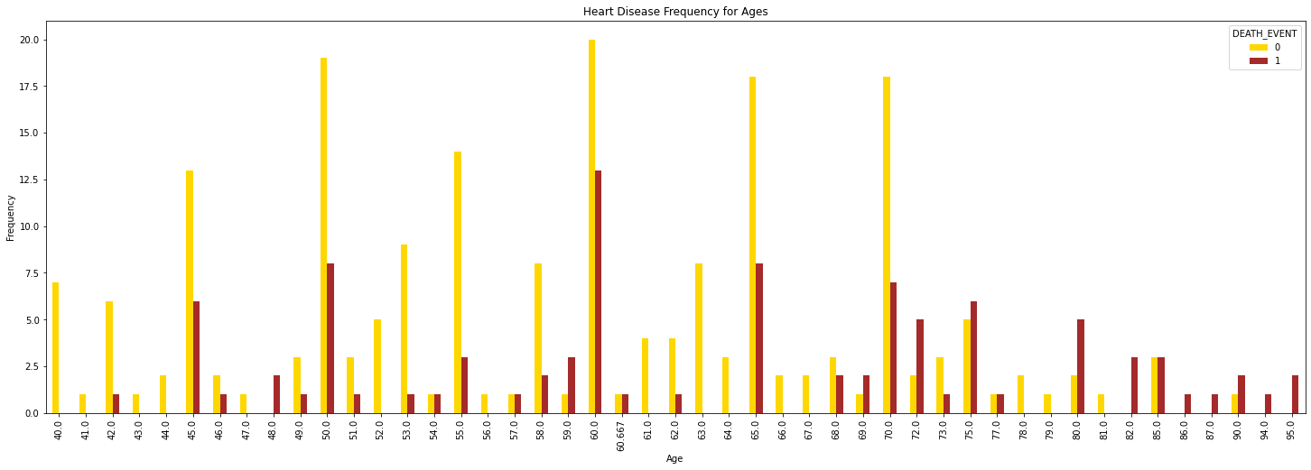
Data Visualization
Heart disease frequency for ages

Slide 4
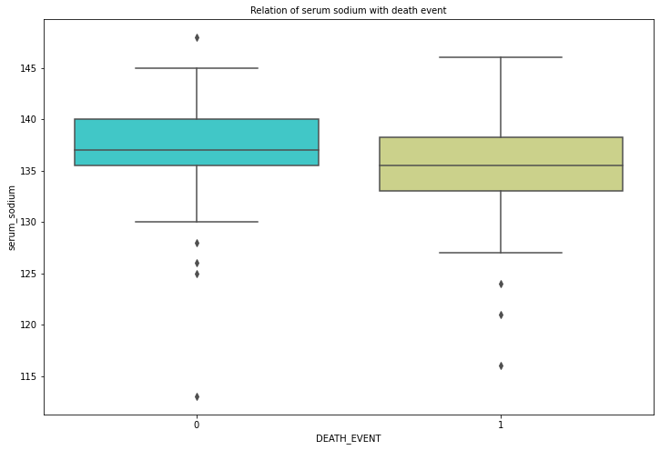
Data Visualization
Relation of serum sodium with death event
Notes:
The plot clearly shows that people who are most likely to not suffer from the heart disease or still alive have a slightly lower serum sodium

Slide 5
Create a Test Set and Training Set
StratifiedShuffleSplit
Combination of both ShuffleSplit and StratifiedKFold
Why this strategy is good?
Because by using StratifiedShuffleSplit the proportion of class labels in the train and test datasets is nearly equal.
However, in StratifiedShuffleSplit, the data is shuffled each time before the split, which means there's a higher likelihood of overlap between the train and test sets.

Slide 6
Types of ML Models
Logistic Regression
Logistic regression can find the relationships between variables.
Support Vector Machine (SVM)
For two-group classification issues, a support vector machine (SVM) is a supervised machine learning model that uses classification techniques. So, you are attempting to solve a text classification issue.

Slide 7
Types of ML Models
RandomForestClassifier
Random forests are an ensemble learning method for classification, regression, and other problems that works by creating a large number of decision trees during training and then outputting the class that is the mean forecast of the individual trees.
MLPClassifier
MLPs are well suited to classification prediction issues in which inputs are classified or labeled.
Notes:
Since we are working on multiple decision trees there is a chance of less over-fitting. Greater Accuracy: Since it runs on a larger data set, the accuracy is higher. Estimate Missing data: Since it runs on a larger data set, you can estimate the missing values as well.

Slide 8
The Performance of All Trained Models
Logistic Regression Accuracy: 0.81 (+/- 0.10)
SVM Linear Accuracy: 0.81 (+/- 0.09)
Random Forest Classifier Accuracy: 0.80 (+/- 0.15) curacy: 0.81 (+/- 0.09)
Neural Network Accuracy: 0.77 (+/- 0.17)
Performance of the best ML model using the test set:
Accuracy of the logistic regression model with test data: 0.8667

Slide 9
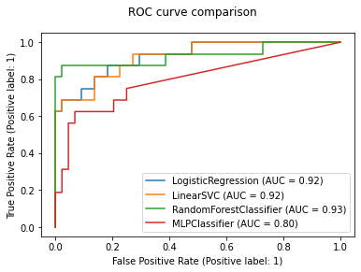

Slide 10
Challenges/Thoughts
Pay a lot of attention to the training data
Look for reasonable solutions to deal with the algorithm's inevitable failures.

Slide 11
THANK YOU

